Slide 1
Android Application Development (I)
Practice – Publish Application (Signed)

Slide 2
Agenda
Self Introduction
Intellectual Property Rights
Project Introduction
Android Introduction
Get Started with Android
Requirement
Object-Oriented Analysis and Design
Scrum
Coding
Acceptance Test Criteria
Publish Application
Notes:
Object-oriented analysis and design (OOAD) is a software engineering approach that models a system as a group of interacting objects. Each object represents some entity of interest in the system being modeled, and is characterised by its class, its state (data elements), and its behavior. Various models can be created to show the static structure, dynamic behavior, and run-time deployment of these collaborating objects. There are a number of different notations for representing these models, such as the Unified Modeling Language (UML).
Object-oriented analysis (OOA) applies object-modeling techniques to analyze the functional requirements for a system. Object-oriented design (OOD) elaborates the analysis models to produce implementation specifications. OOA focuses on what the system does, OOD on how the system does it.
Ref: http://en.wikipedia.org/wiki/Object-oriented_analysis_and_design
IFRS - International Financial Reporting Standards
GAAP - Generally Accepted Accounting Principles

Slide 3
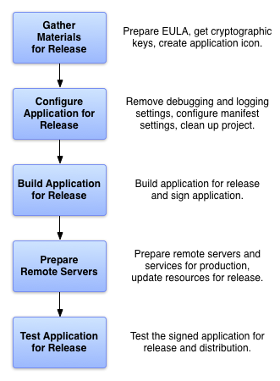

Publish Application
Signing in Debug Mode
When you run or debug your application, ADT signs the .apk with the debug certificate, runs zipalign on the package, then installs it on the selected emulator or connected device. No specific action on your part is needed.
Note: The self-signed certificate used to sign your application in debug mode will have an expiration date of 365 days from its creation date.
Signing in Release Mode
Obtain a suitable private key
Compile the application in release mode
Sign your application with your private key
Align the final APK package
Hints: Export Wizard in Eclipse will help you
export a signed .apk (and even create a new
keystore, if necessary).
[Ref to Compile and sign with Eclipse ADT]
[Ref to Preparing for Release]

Slide 4
What is Signing for Application?
Signing is the process of digitally signing executables
and scripts to confirm the software author and guarantee that the code has not been altered or corrupted

Slide 5
Why Do We Need to Sign an Application?
The Android system requires that all installed applications be digitally signed with a certificate whose private key is held by the application's developer.
Uses the certificate as a means of identifying the author of an application and establishing trust relationships between applications

Slide 6
Signing Strategies
Application Upgrade
As you release updates to your application, you will want to continue to sign the updates with the same certificate or set of certificates
Application Modularity
The Android system allows applications that are signed by the same certificate to run in the same process
Code/Data Sharing Through Permissions
The Android system provides signature-based permissions enforcement, so that an application can expose functionality to another application that is signed with a specified certificate

Slide 7
What is Certificate?
The certificate is a digital file generated by some tool such as keytool in Java SDK.
The certificate is not used to control which applications the user can install.
The certificate does not need to be signed by a certificate authority

Slide 8
Important Tips for Signing and Certificates
All applications must be signed.
The system will not install an application that is not signed.
You can use self-signed certificates to sign your applications.
No certificate authority is needed.
When you are ready to release your application for end-users, you must sign it with a suitable private key.
You can not publish an application that is signed with the debug key generated by the SDK tools.

Slide 9
Important Tips for Signing and Certificates Cont.
The system tests a signer certificate's expiration date only at install time.
If an application's signer certificate expires after the application is installed, the application will continue to function normally.
Keytool and Jarsigner
To generate keys and sign your application .apk files
zipalign
Once you have signed the application, use the tool to optimize the final APK package.

Slide 10
How to sign an application? Step1: Setting Application Version
android:versionCode
An integer value that represents the version of the application code, relative to other versions.
android:versionName
A string value that represents the release version of the application code, as it should be shown to users.

Slide 11
How to sign an application? Step2: Specifying System API Requirements
android:minSdkVersion
The minimum version of the Android platform on which the application will run
android:targetSdkVersion
Specifies the API Level on which the application is designed to run or behaviors defined in the target API Level, rather than being restricted to using only those defined for the minimum API Level.
android:maxSdkVersion
The maximum version of the Android platform on which the application is designed to run, specified by the platform's API Level

Slide 12
How to sign an application? Step3: Gathering Materials and Resources
Cryptographic keys
Your application must be signed with a cryptographic key whose validity period ends after 22 October 2033.
Application Icon
If you are releasing your application on Android Market, you need to create a high resolution version of your icon.
End-user License Agreement
A EULA can help protect your person, organization, and intellectual property, and we recommend that you provide one with your application.

Slide 13
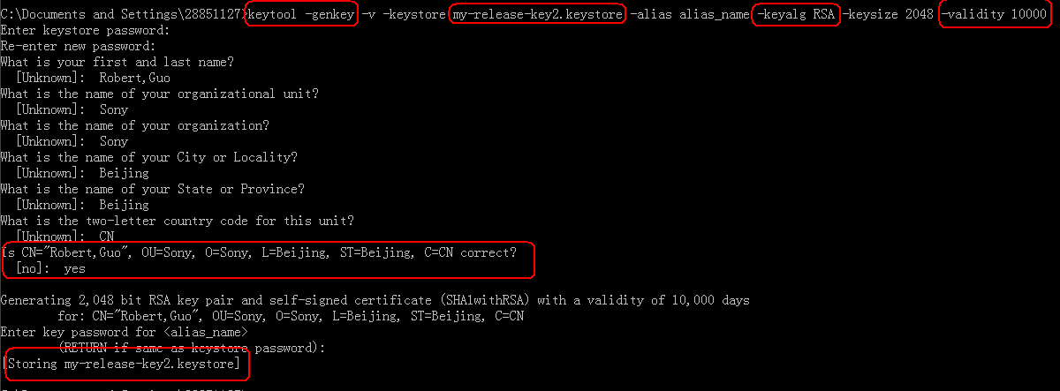
How to sign an application? Step4: Get a Certificate by Following Steps

Slide 14
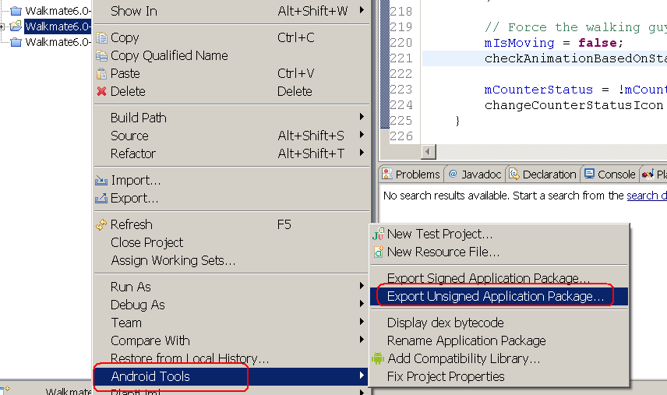
How to sign an application? Step5: Get the Application in Release Mode
In release mode, the compiled application is not signed by default and you will need to sign it with your private key.

Slide 15
How to sign an application? Step6: Sign Your Application with Your Private Key
To sign your application, you run Jarsigner, referencing both the application's .apk and the keystore containing the private key with which to sign the .apk
jarsigner -verbose -keystore my-release-key.keystore my_application.apk alias_name
Check the result for signed application
jarsigner -verify –verbose my_application.apk

Slide 16
How to sign an application? Step7: Align the final APK package
Ensure that all uncompressed data starts with a particular byte alignment, relative to the start of the file.
Ensure the alignment at 4-byte boundaries provides a performance optimization when installed on a device
zipalign -v 4 your_project_name-unaligned.apk your_project_name.apk

